Slide 1
WFSF Programme Accreditation Process
Notes:
Thank you for your interest in the programme Accreditation process offered by the World Futures Studies Federation.

Slide 2
Notes:
The Federation was formed in 1973 to develop futures studies as an academic discipline in view of alternative visions for humanity.

Slide 3
Programme Accreditation Work Group
“How can the Federation best support its academic members as they establish futures studies programmes?”
Notes:
In 2018 the Federation formed an Institutional Accreditation work group to consider how it could support its academic members as they establish futures studies programme within tertiary educational institutions.

Slide 4
Recent Survey of Academic Futurists
67% of programmes are older than 6 years
Nearly 60% of academics indicated that they would be interested in foresight education workshops
Almost half deliver programmes in blended mode
91% of programmes are NOT institutional members
Strong support from respondents for the proposed standards for accreditation
Notes:
In a recent Federation member survey, nearly 60% of academics indicated that they would be interested in workshops related to building high quality, innovative, and foresight education programme.

Slide 5
Programme Accreditation: Why?
Emphasise intellectual and professional value of foresight programmes
Encourage innovation and experimentation, growth and quality in foresight education.
Assure high quality of foresight programme(s)
Flexible and useful to a broad range of missions, departments, schools or colleges and universities, which operate under diverse legislative frameworks.
Opportunity for self-study and programme development.
Transparent, evidence-based programme improvement in foresight education.

Slide 6
Accreditation Process
Notes:
Is your futures studies programme ready for accreditation? Foresight programmes interested in accreditation are invited to study the Council's pre-conditions for Eligibility as a Candidate and the Federation's Six Accreditation Standards that guide a programme’s self-assessment.

Slide 7
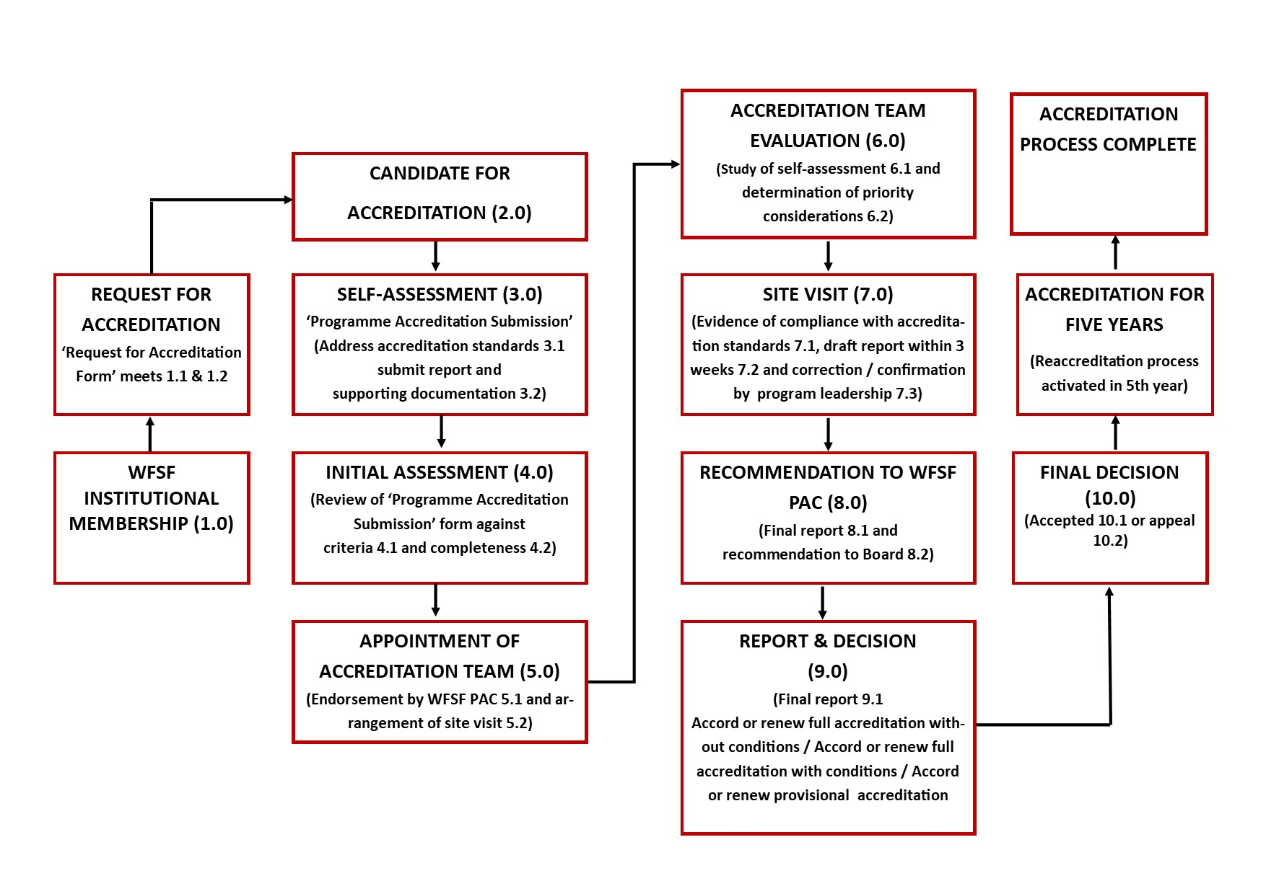
Accreditation Process
3
Notes:
3-step accreditation process.

Slide 8
Accreditation Process
1
2
3
3
Notes:
In response the Federation has now launched a three step self-assessment and review process by which programme directors and faculty of foresight programme may formally apply to receive accreditation as a "Foresight Education programme."

Slide 9
Who is Eligible for Accreditation?
Preconditions
0.1: Futures Studies
0.2: Credential Granting
0.3: Governmental Approval
0.4: Institutionally Accredited
0.5: Sufficient Term of Existence
0.6: Administrative Unit
0.7: Mode and Location of Delivery
0.8: Institutional Membership

Slide 10
Accreditation Process
Join as Institutional Member of WFSF
Document how you meet the 8 Preconditions
Engage in continuous improvement
Submit annual Reports
1
Eligibility
2
Candidacy
Accreditation
WFSF Accreditation Request form https://accreditation.wfsf.org
Notes:
The three steps to accreditation by university programme are as follows. Step one is Eligibility. The university programme must join the Federation as an “Institutional Member" and document how its meets the 8 Preconditions for Eligibility to pre-qualify them as a candidate for accreditation.

Slide 11
Six Standards and sub-criteria
1.0. Mission Standards 1.1: Mission Statement 1.2: Programme Outcomes 1.3: Multi-Year Plan 1.4: Qualified Officers | 3.0. Curriculum Standards 3.1: Peer Benchmarking 3.2: Award Level 3.3: Foresight Component 3.4: Transfer Credit | 5.0. Student Standards 5.1: Admission Requirements 5.2: Student Achievement 5.3: Academic Information
2.0. Faculty Standards 2.1: Qualified Faculty Ratio 2.2: Academically Qualified 2.3: Professionally Qualified 2.4: Faculty Review Process 2.5: Full-Time Faculty Ratio 2.6: Teaching Workloads 2.7: Faculty Engagement | 4.0. Instructional Standards 4.1: Curriculum Review 4.2: Outcome Assessments 4.3: Defined Assessments 4.4: Faculty Performance 4.5: Assessment Plan | 6.0. Resource Standards 6.1: Library Resources 6.2: Information Technology 6.3: Instructional Technology 6.4: Professional Support 6.5: Administrative Support 6.6: Enrollment Support

Slide 12
Accreditation Process
Join as an Institutional Member of WFSF
Document how you meet the 8 Preconditions
Conduct a self assessment review against the six accreditation standards
Host a WFSF accreditation site visit
Engage in continuous improvement
Submit annual Reports
1
Eligibility
2
Candidacy
WFSF Accreditation Request form https://accreditation.wfsf.org
WFSF Accreditation Submission form
Notes:
Once a university files an initial Eligibility Application for Accreditation, and is found eligible, they may proceed to the second stage, a Candidacy Application with a fee. During this stage, the Candidate begins to analyze their strengths and weaknesses, and consider how they might document their compliance with the Federation's accreditation standards. They would then submit an Accreditation Submission. An accreditation team will be constituted to conduct a site visit and evaluate the submission against the WFSF Accreditation Standards. An accreditation report is formulated by the accreditation team.

Slide 13
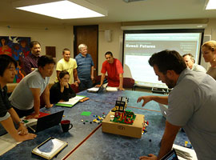
Accreditation Process
Conduct a self assessment review against the six accreditation standards
Host a WFSF accreditation site visit
Engage in continuous improvement
Submit annual Reports
2
Candidacy
Notes:
The Candidacy stage can last as little as 6 months or as long as 20 months. During this stage the Candidate conducts an internal self-assessment of all aspects of their programme. As Candidates, they have access to the Federations’ services, whether through international workshops, video consultations or document reviews.

Slide 14
Accreditation Process
Join as an Institutional Member of WFSF
Document how you meet the 8 Preconditions
Conduct a self assessment review against the six accreditation standards
Host a WFSF accreditation site visit
Accreditation granted
Engage in continuous improvement
Submit annual Reports
1
Eligibility
2
Candidacy
3
Accredited
WFSF Accreditation Request form https://accreditation.wfsf.org
WFSF Accreditation Submission form
5-Year Accreditation Granted WFSF Accreditation Annual Reports
Notes:
The WFSF programme Accreditation Council makes a recommendation to the WFSF recommending that accreditation status be granted or not granted. programmes engage in continuous improvement and submit annual reports for 5 years (term of ) accreditation

Slide 15
Six Accreditation Standards
1. Mission Standards 2. Faculty Standards 3. Curriculum Standards 4. Instructional Standards 5. Student Standards 6. Resource Standards
Notes:
The programmes’ self-assessment report provides evidence on how their programme meets the Six Accreditation quality standards of the Programme Accreditation Council, addressing Mission, Faculty, Curriculum, Instructional, Students, and Resources. In response, the Federation forms an accreditation team to review the self assessment report prior to a visit, where they examine all aspects of the university programme and its support services.

Slide 16
Accreditation Seal
Notes:
Upon review of the Site Visit, the programme Accreditation Council makes a recommendation to the Board of the Federation as to whether the programme meets the standards. The Board then notifies the programme of their accreditation decision. Upon receiving accreditation, the university can display the Federation’s accreditation seal in its marketing and serve as a model to other futures studies programmes worldwide.

